Slide 1
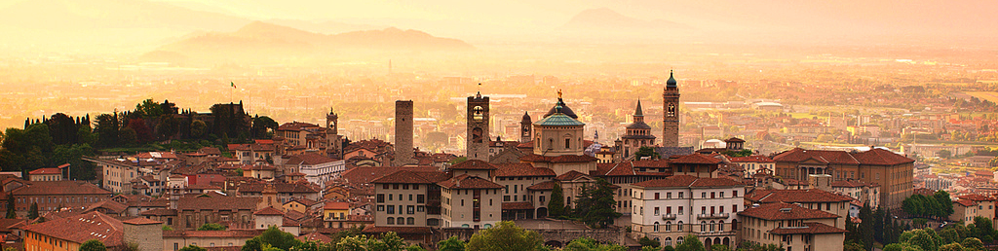

10th Joint Meeting of the European Software Engineering Conference and the ACM SIGSOFT Symposium on the Foundations of Software Engineering: FSE’15
GALE: Geometric active learning for Search-Based Software Engineering
Joseph Krall, LoadIQ
Tim Menzies, NC State
Misty Davies, NASA Ames
Sept 5, 2015
Slides: tiny.cc/gale15
Software: tiny.cc/gale15code
ai4se.net

Slide 2

This talk
What is search-based SE?
Why use less CPU for SBSE?
How to use less CPU
Refactor the optimizer:
Add in some data mining
Experimental results
Related Work
Future work
A challenge question:
Are we making this too hard?
ai4se.net

Slide 3
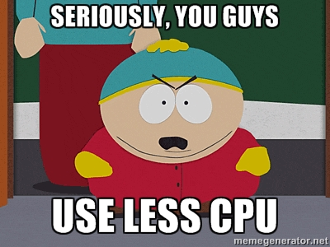

Slide 4
This talk
What is search-based SE?
Why use less CPU for SBSE?
How to use less CPU
Refactor the optimizer:
Add in some data mining
Experimental results
Related Work
Future work
A challenge question:
Are we making this too hard?
ai4se.net

Slide 5

Q: What is Search-based SE? A: The future
Ye olde SE
Manually code up your understanding a domain
Struggle to understand that software
Search-based- model-based SE
Code up domain knowledge into a model
Explore that model
All models are wrong
But some are useful

Slide 6
SBSE = everything
1. Requirements Menzies, Feather, Bagnall, Mansouri, Zhang
2. Transformation Cooper, Ryan, Schielke, Subramanian, Fatiregun, Williams
3.Effort prediction Aguilar-Ruiz, Burgess, Dolado, Lefley, Shepperd
4. Management Alba, Antoniol, Chicano, Di Pentam Greer, Ruhe
5. Heap allocation Cohen, Kooi, Srisa-an
6. Regression test Li, Yoo, Elbaum, Rothermel, Walcott, Soffa, Kampfhamer
7. SOA Canfora, Di Penta, Esposito, Villani
8. Refactoring Antoniol, Briand, Cinneide, O’Keeffe, Merlo, Seng, Tratt
9. Test Generation Alba, Binkley, Bottaci, Briand, Chicano, Clark, Cohen, Gutjahr, Harrold, Holcombe, Jones, Korel, Pargass, Reformat, Roper, McMinn, Michael, Sthamer, Tracy, Tonella,Xanthakis, Xiao, Wegener, Wilkins
10. Maintenance Antoniol, Lutz, Di Penta, Madhavi, Mancoridis, Mitchell, Swift
11. Model checking Alba, Chicano, Godefroid
12. Probing Cohen, Elbaum
13. UIOs Derderian, Guo, Hierons
14. Comprehension Gold, Li, Mahdavi
15. Protocols Alba, Clark, Jacob, Troya
16. Component sel Baker, Skaliotis, Steinhofel, Yoo
17. Agent Oriented Haas, Peysakhov, Sinclair, Shami, Mancoridis
ai4se.net

Slide 7
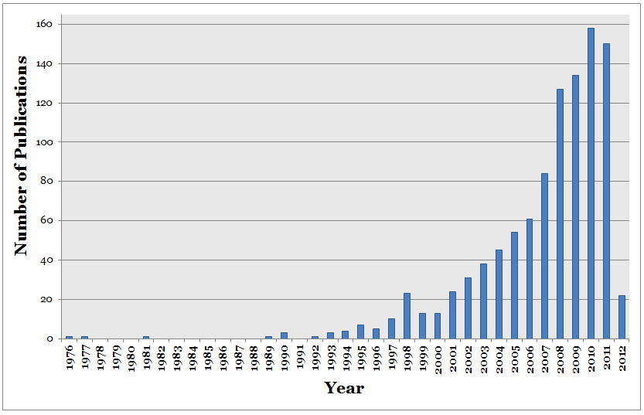
SBSE = CPU-intensive
Explosive growth of SBSE papers
ai4se.net

Slide 8
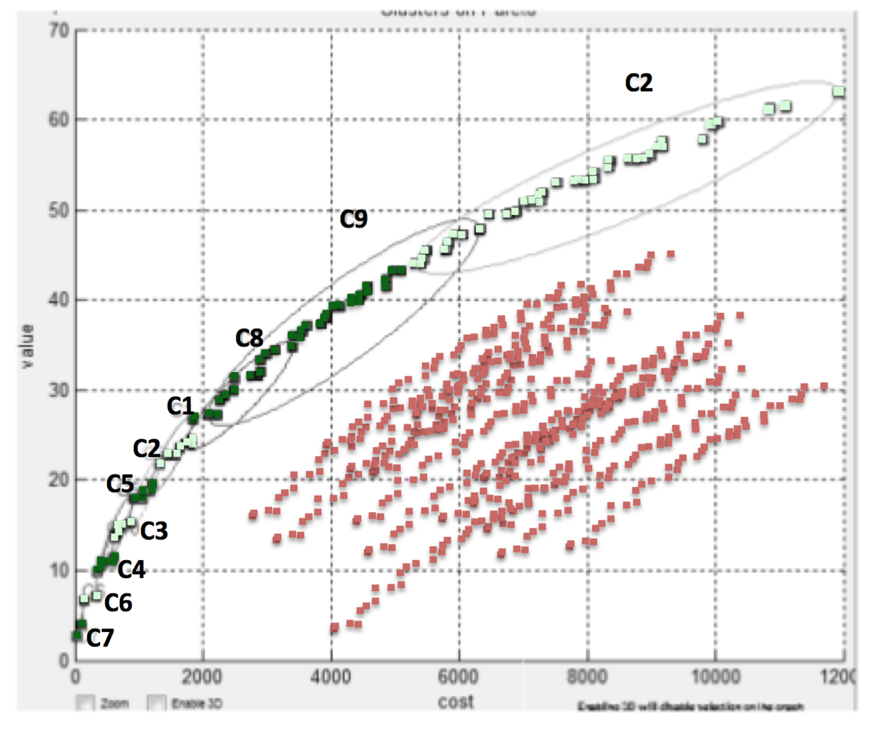
SBSE = CPU-intensive
Explosive growth of SBSE papers
Evaluates 1000s, 1,000,000s of candidates
Objectives = evaluate(decisions)
Cost = Generations * (Selection + Evaluation * Generation)
G * (O(N²) + E * O(1) * N)
ai4se.net

Slide 9
This talk
What is search-based SE?
Why use less CPU for SBSE?
How to use less CPU
Refactor the optimizer:
Add in some data mining
Experimental results
Related Work
Future work
A challenge question:
Are we making this too hard?
ai4se.net

Slide 10
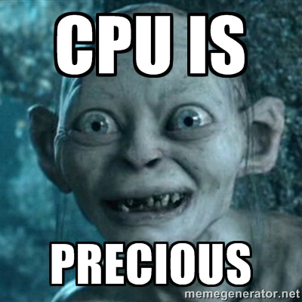
Why seek less CPU?
• Less power
Less power generation pollution
Less barriers to usage
Less cost
of hardware of cloud time

Slide 11
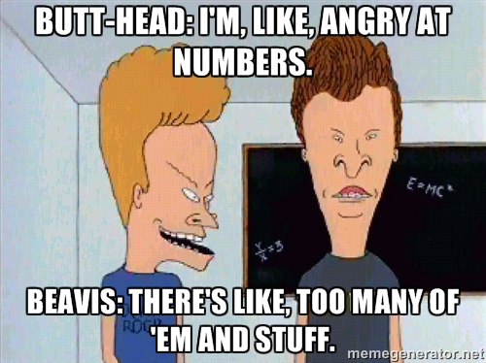
Why seek less CPU?
• Less generation of candidates
Less confusion
Verrappa and Letier:
“..for industrial problems, these algorithms generate (many) solutions (makes) understanding them and selecting one among them difficult and time consuming” https://goo.gl/LvsQdn

Slide 12
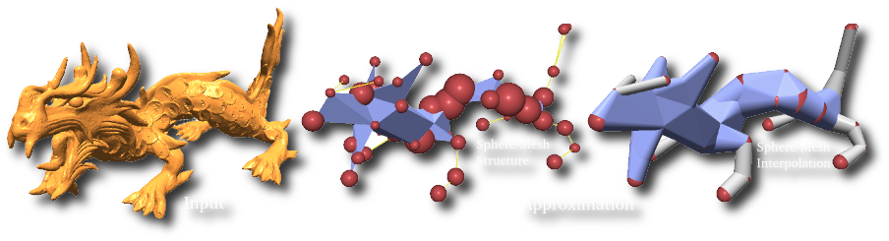
When searching for solutions “you don’t need all that detail”
In Computer
Graphics
In Machine learning
In Theorem proving
In Software Eng.
Variable subset selection (Kohavi, 1997)
Instance selection (Chen, 1975)
Active learning
Narrows (Amarel, 1986)
Master variables (Crawford 1995)
Back doors (Selman 2002).
Saturation in mutation testing (Budd, 1980 and many others

Slide 13
This talk
What is search-based SE?
Why use less CPU for SBSE?
How to use less CPU
Refactor the optimizer:
Add in some data mining
Experimental results
Related Work
Future work
A challenge question:
Are we making this too hard?
ai4se.net

Slide 14
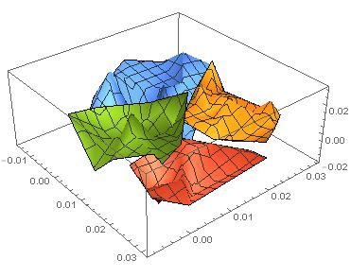
How to use less CPU (for SBSE)
Objectives = evaluate(decisions)
Generations *( Selection + Evaluation * Generation)
G * ( O(N²) + E * O(1)*N )
ai4se.net

Slide 15
How to use less CPU (for SBSE)
Objectives = evaluate(decisions)
Generations * (Selection + Evaluation * Generation)
G * ( O(N²) + E * O(1)*N )
Approximate the space
k=2 divisive clustering
ai4se.net

Slide 16
How to use less CPU (for SBSE)
Objectives = evaluate(decisions)
Generations * (Selection + Evaluation * Generation)
G * ( O(N²) + E * O(1)*N )
Approximate the space
k=2 divisive clustering
(X,Y)= 2 very distant points in O(2N)
ai4se.net

Slide 17
How to use less CPU (for SBSE)
Objectives = evaluate(decisions)
Generations * (Selection + Evaluation * Generation)
G * ( O(N²) + E * O(1)*N )
Approximate the space
k=2 divisive clustering
(X,Y)= 2 very distant points in O(2N)
Evaluate only (X,Y)
ai4se.net

Slide 18
How to use less CPU (for SBSE)
Objectives = evaluate(decisions)
Generations * (Selection + Evaluation * Generation)
G * ( O(N²) + E * O(1)*N )
Approximate the space
k=2 divisive clustering
(X,Y)= 2 very distant points in O(2N)
Evaluate only (X,Y)
If better(X,Y)
If size(cluster) > sqrt(N)
Split, recurse on better half
E.g. cull red
Else, push points towards X
E.g. push orange
ai4se.net

Slide 19
How to use less CPU (for SBSE)
Objectives = evaluate(decisions)
Generations * (Selection + Evaluation * Generation)
G * ( O(N²) + E * O(1)*N )
Approximate the space
k=2 divisive clustering
(X,Y)= 2 very distant points in O(2N)
Evaluate only (X,Y)
If better(X,Y)
If size(cluster) > sqrt(N)
Split, recurse on better half
E.g. cull red
Else, push points towards X
E.g. push orange
Red is culled
ai4se.net

Slide 20
How to use less CPU (for SBSE)
Objectives = evaluate(decisions)
Generations * (Selection + Evaluation * Generation)
G * ( O(N²) + E * O(1)*N )
Approximate the space
k=2 divisive clustering
(X,Y)= 2 very distant points in O(2N)
Evaluate only (X,Y)
If better(X,Y)
If size(cluster) > sqrt(N)
Split, recurse on better half
E.g. cull red
Else, push points towards X
E.g. push orange
e.g. orange points get pushed this way
Red is culled
ai4se.net

Slide 21
How to use less CPU (for SBSE)
Objectives = evaluate(decisions)
Generations * (Selection + Evaluation * Generation)
G * (O(N²) + E * O(1)*N)
Approximate the space
k=2 divisive clustering
(X,Y)= 2 very distant points in O(2N)
Evaluate only (X,Y)
If better(X,Y)
If size(cluster) > sqrt(N)
Split, recurse on better half
E.g. cull red
Else, push points towards X
E.g. push orange
g * ( O(N) + log( E * O(1) * N))
e.g. orange points get pushed this way
Red is culled
ai4se.net

Slide 22
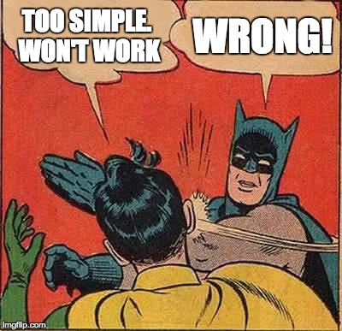

Slide 23
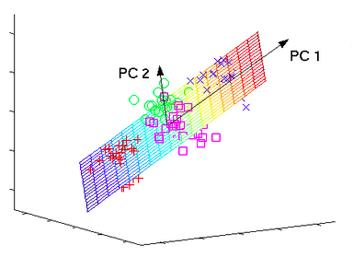
GALE’s clustering = fast analog for PCA (so GALE is a heuristic spectral learner)
ai4se.net
23

Slide 24
This talk
What is search-based SE?
Why use less CPU for SBSE?
How to use less CPU
Refactor the optimizer:
Add in some data mining
Experimental results
Related Work
Future work
A challenge question:
Are we making this too hard?
ai4se.net
24

Slide 25
Sample models
Benchmark suites (small)
SE models
The usual suspects: goo.gl/FTyhkJ
2-3 line equations
Fonseca, Schaffer, woBar. Golinski,
Also, from goo.gl/w98wxu
The ZDT suite :
The DTLZ suite
On-line at: goo.gl/nv2AVK
XOMO: goo.gl/tY4nLu COCOMO software effort estimator + defect prediction + risk advisor
POM3: goo.gl/RMxWC Agile teams prioritizing tasks
Tasks costs and utility may subsequently change
Teams depend on products from other teams
Internal NASA models:
CDA: goo.gl/wLVrYA
NASA’s requirements models for human avionics

Slide 26
Comparison algorithms
What we used (in paper)
Since paper
NSGA-II (of course)
SPEA2
Selected from Sayyad et al’s ICSE’13 survey of “usually used MOEAs in SE”
Not IBEA:
BTW, I don’t like IBEA, just its continuous domination function
Used in GALE
Differential evolution
MOEA/D
?NSGA III
Some quirky “bunching problems”

Slide 27
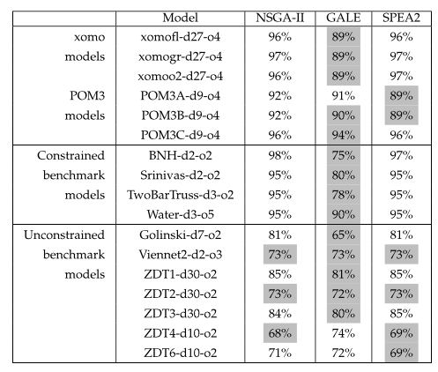
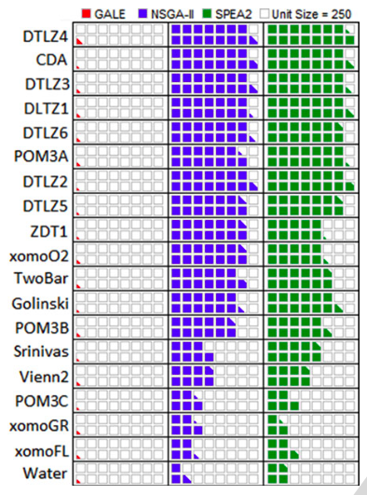
GALE: one of the best, far fewer evals
Gray: stats tests: as good as the best
ai4se.net

Slide 28
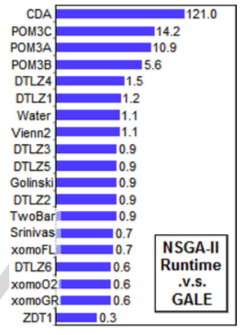
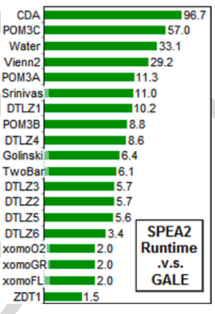
For small models, not much slower For big models, 100 times faster
ai4se.net

Slide 29
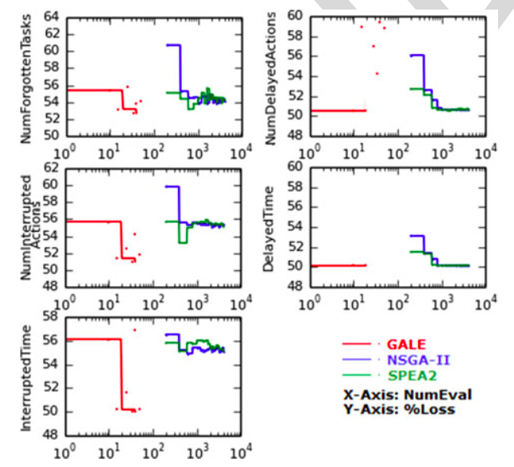
On big models, GALE does very well
NASA’s requirements models for human avionics
• GALE: 4 mins
• NSGA-II: 8 hours
ai4se.net

Slide 30
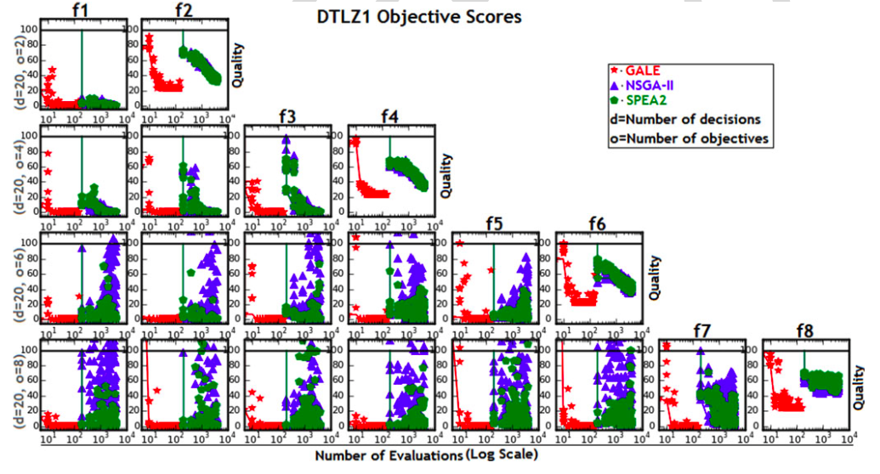
DTLZ1:from 2 to 8 goals
ai4se.net

Slide 31
This talk
What is search-based SE?
Why use less CPU for SBSE?
How to use less CPU
Refactor the optimizer:
Add in some data mining
Experimental results
Related Work
Future work
A challenge question:
Are we making this too hard?
ai4se.net

Slide 32
Related work (more)
[X] = reference
in paper
Active learning [8]
Don’t evaluate all,
Just the most interesting
Kamvar et al. 2003 [33]
Spectral learning
Boley , PDDP 1998 [34]
Classification, recursive descent on PCA component
O(N²), not O(N)
SPEA2, NSGA-II, PSO, DE, MOEA/D, Tabu..
All O(N) evaluations
Various local search methods (Peng [40])
None known in SE
None boasting GALE’s reduced runtimes
Response surface methods Zuluaga [8]
Parametric assumptions about Pareto frontier
Active learning

Slide 33
This talk
What is search-based SE?
Why use less CPU SBSE?
How to use less CPU
Refactor the optimizer:
Add in some data mining
Experimental results
Related Work
Future work
A challenge question:
Are we making this too hard?
ai4se.net

Slide 34
Future work
More Models
More Tool Building
Siegmund & Apel’s runtime configuration models
Rungta’s NASA models of space pilots flying MARS missions
100s of Horkoff’s softgoal models
Software product lines
Explanation systems
Complex MOEA tasks solved by reflecting on only a few dozen examples
Human in the loop guidance for the inference?
There remains one loophole GALE did not exploit
So after GALE comes STORM,
Work in progress

Slide 35
This talk
What is search-based SE?
Why use less CPU for SBSE?
How to use less CPU
Refactor the optimizer:
Add in some data mining
Experimental results
Related Work
Future work
A challenge question:
Are we making this too hard?
ai4se.net

Slide 36
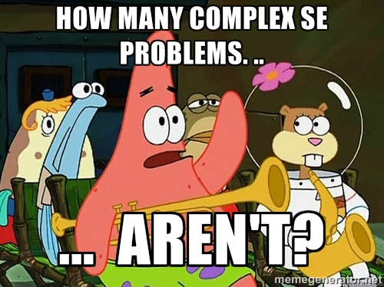

Slide 37
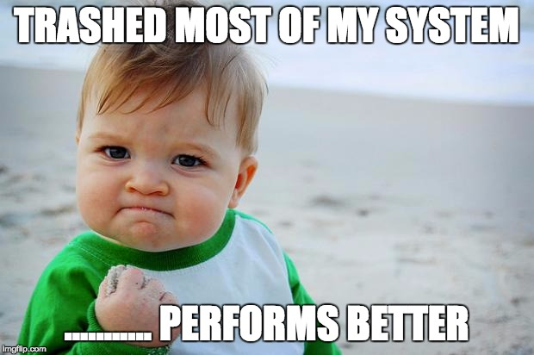
GALE’s dangerous idea
Simple approximations exist for seemingly complex problems.
Researchers jump to the complex before exploring the simpler.
Test supposedly sophisticated vs simpler alternates (the straw man).
My career: “my straw don’t burn”
ai4se.net

Slide 39
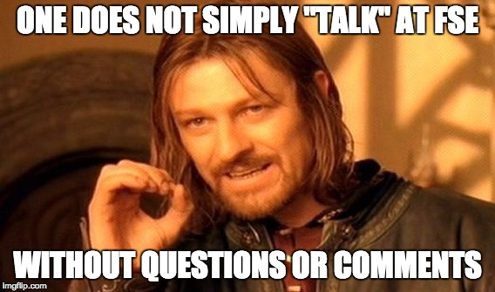
Slides: tiny.cc/gale15
Software: tiny.cc/gale15code
ai4se.net

